Slide 1
fabrication technology
G. M. Parsanasab

Slide 2
Fabrication technology
Lithography
Etching
Photo-mask Making & Direct writing
Thin film deposition
Ion Diffusion & Implantation
Epitaxial growth
Characterizations

Slide 3
Fabrication technology
Lithography
UV Photolithography
X-Ray lithography
Imprint Lithography
Etching
Wet Etching
Dry Etching (Ion Etching)
Reactive Ion Etching (RIE)
Deep Reactive Ion Etching

Slide 4
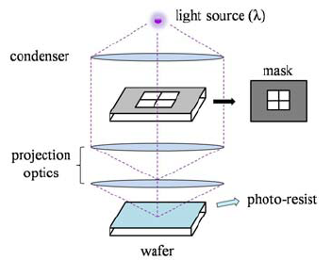
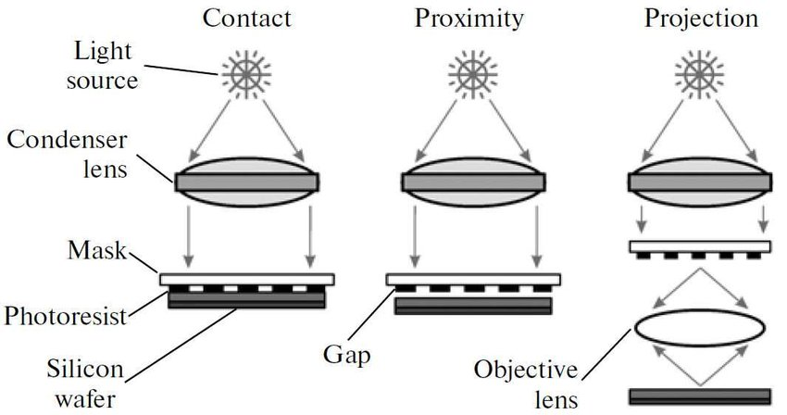
Lithography

Slide 5
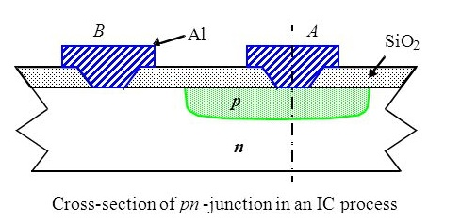
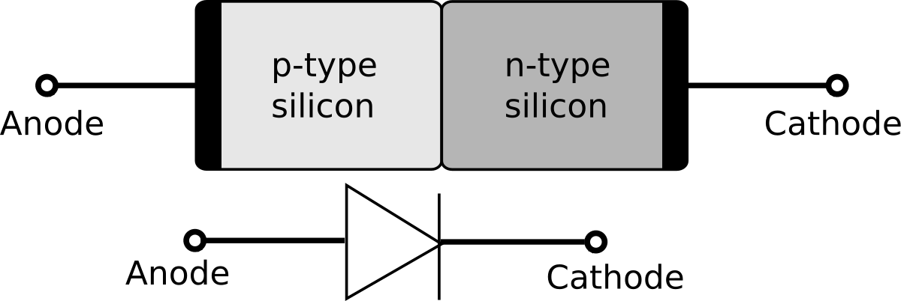
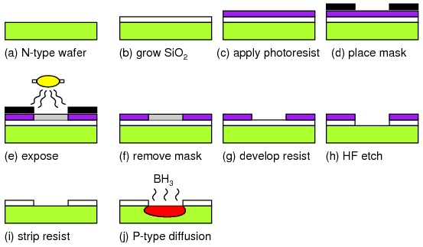
Lithography

Slide 6
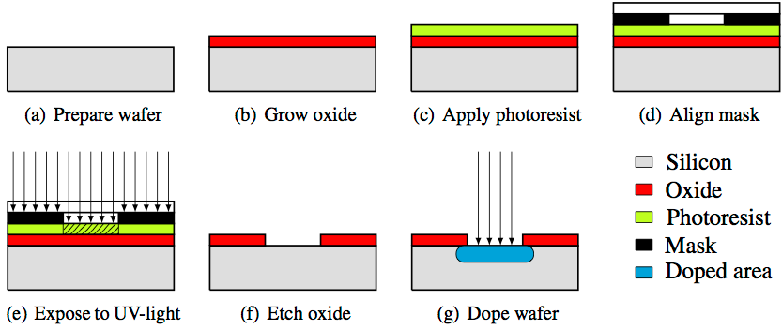

Slide 7

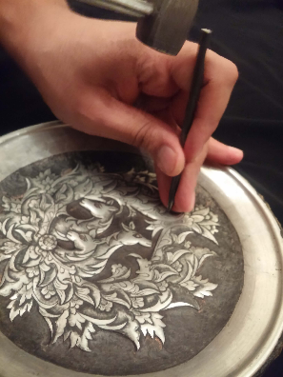
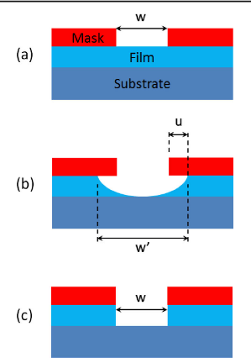
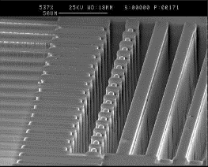
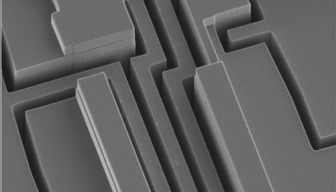
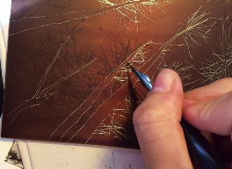
Etching

Slide 8
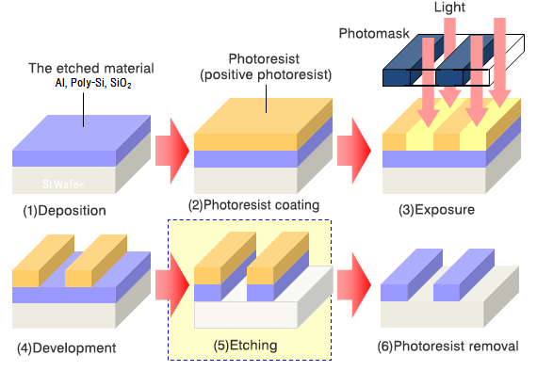
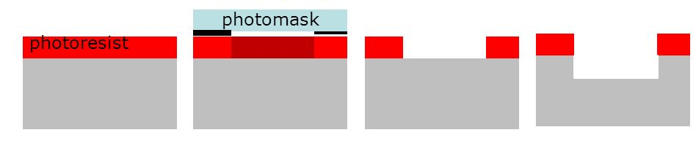
Etching

Slide 9
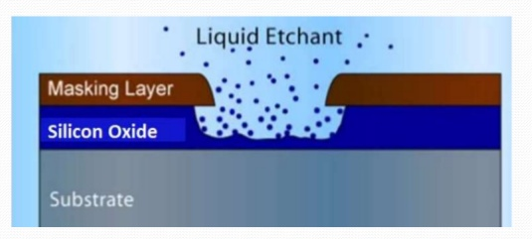
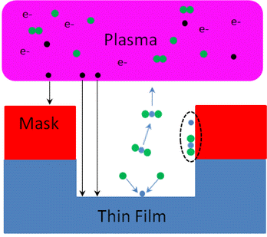
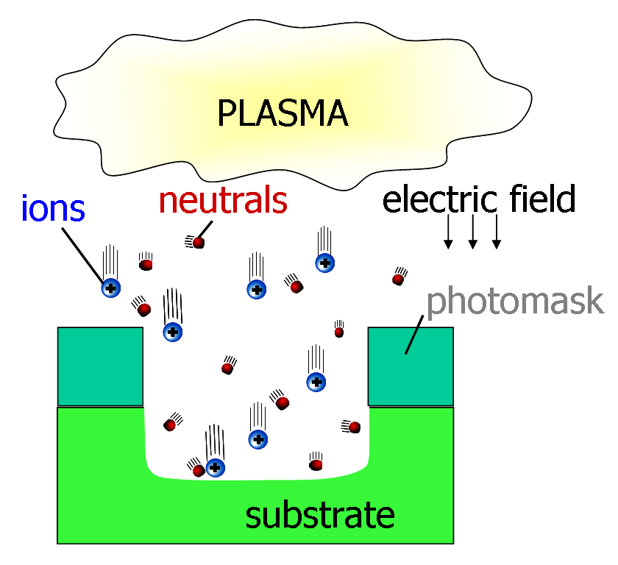
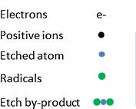
a) Wet Etching b) Ion Etching c) Reactive Ion Etching
Wet Etching
Reactive Ion Etching
Ion Etching

Slide 10
Fabrication technology
Photo-mask Making & Direct writing
Laser Direct Write (Visible & UV)
Electron Beam Lithography (EBL)
Ion Beam Lithography
Femtosecond laser lithography (IR)
Ion Focused Beam milling

Slide 11
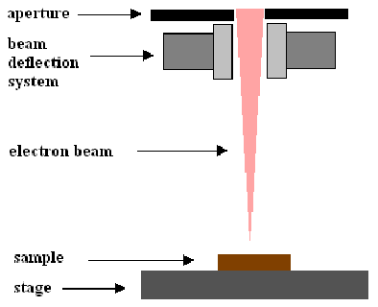
Photo-mask Making & Direct writing

Slide 12
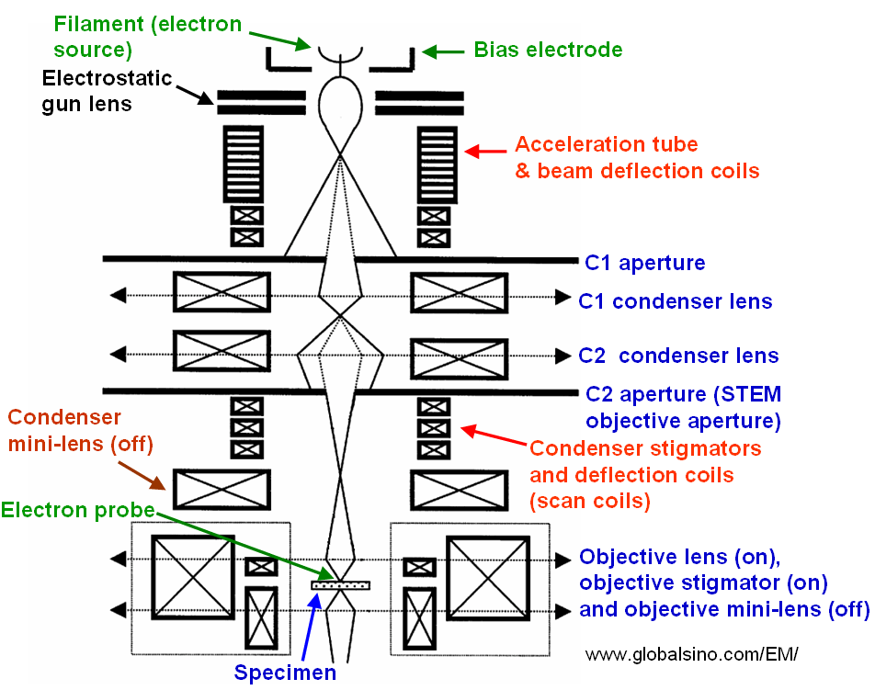

Slide 13
Fabrication technology
Thin film deposition
Thermal evaporator
Electron Gun evaporator
DC and RF Sputtering
Pulsed laser Deposition (PLD)
Electro-Chemical Deposition (Electroplating)

Slide 14
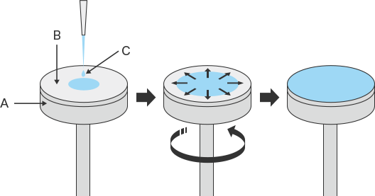
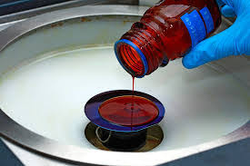
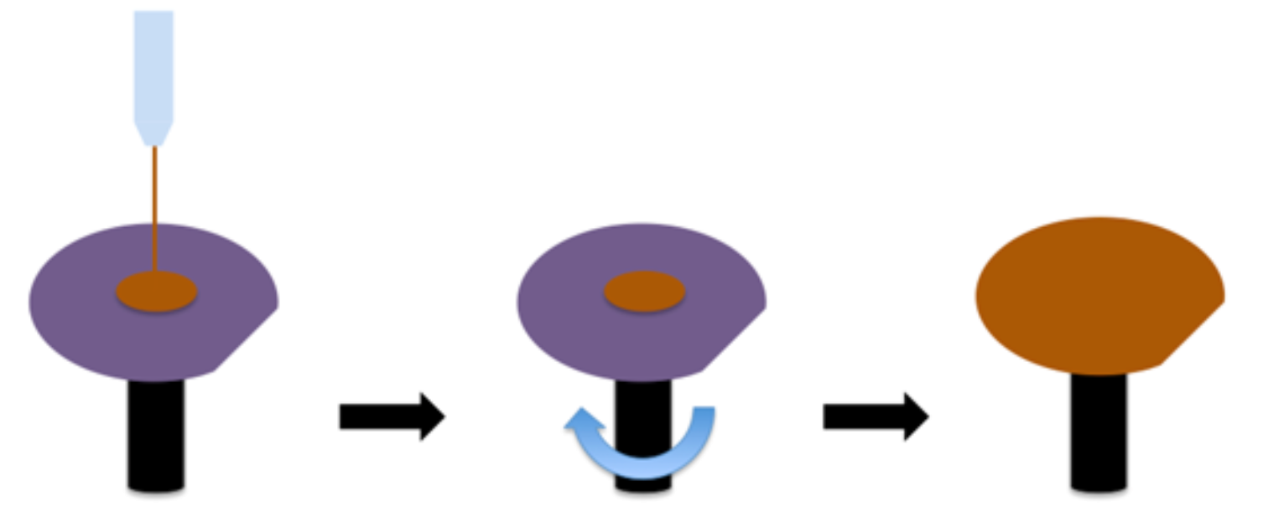
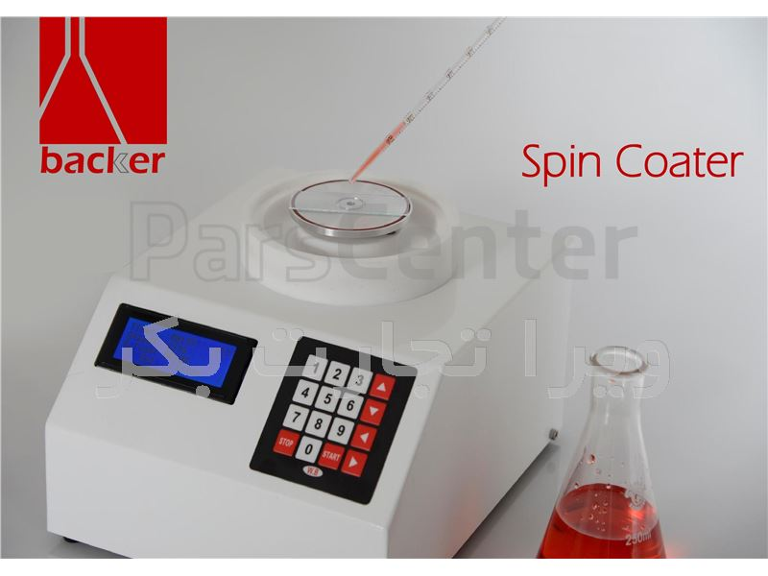
spin coating

Slide 15
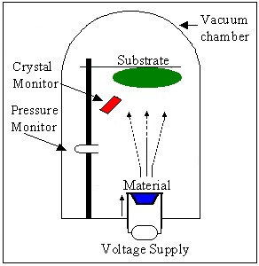
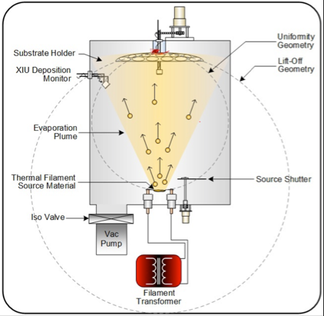
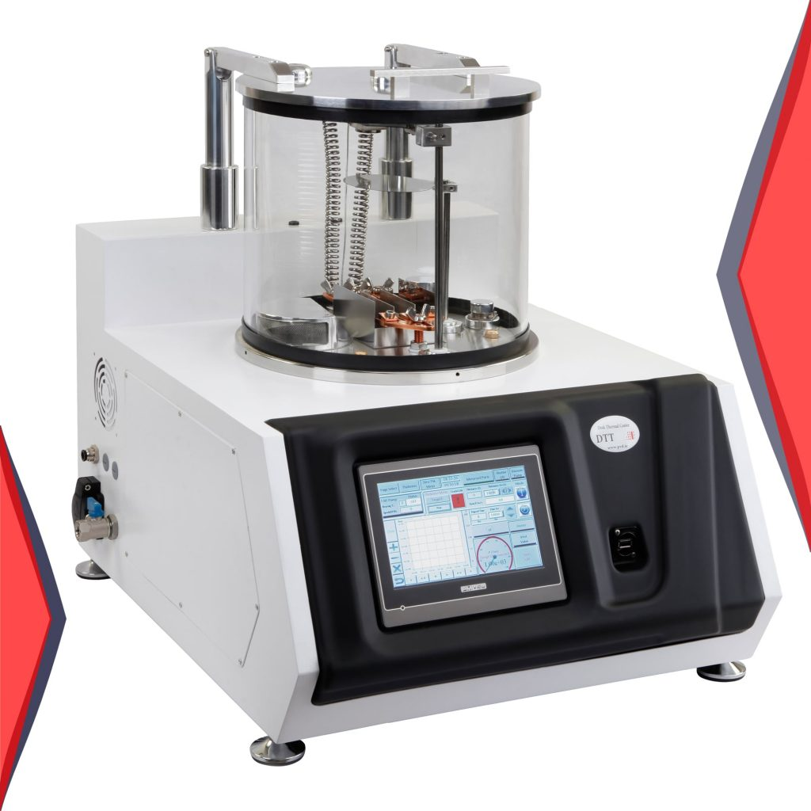
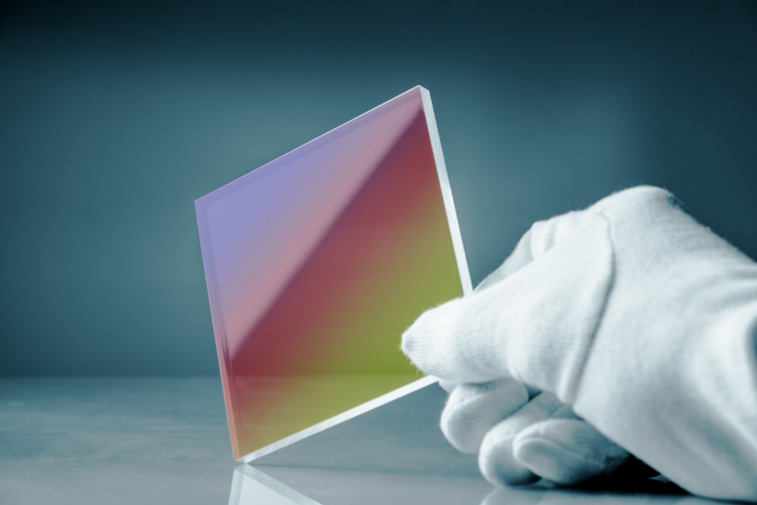
thermal evaporator

Slide 16
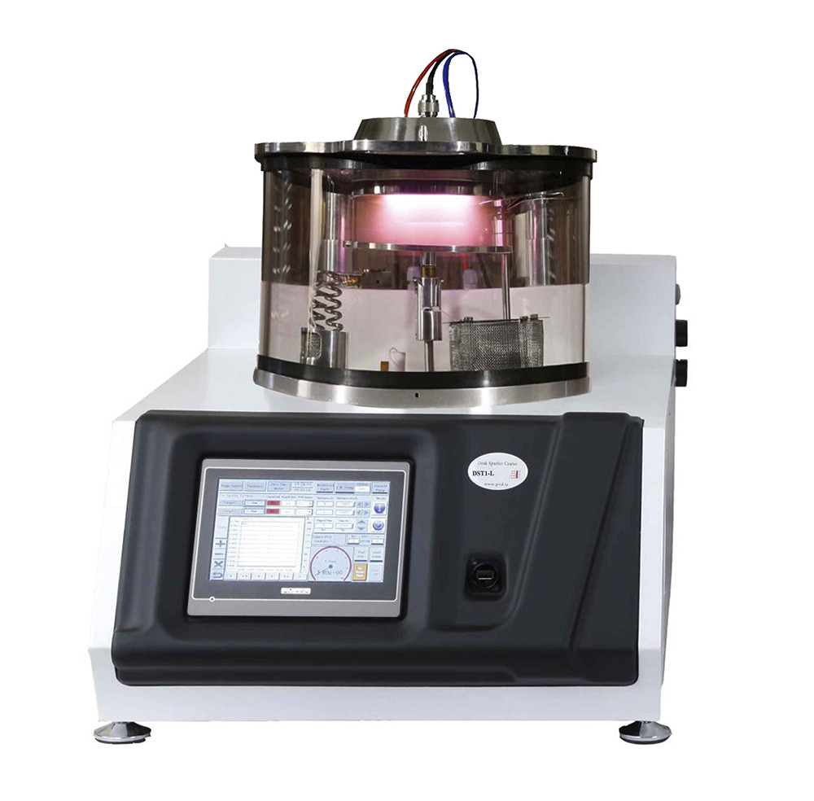
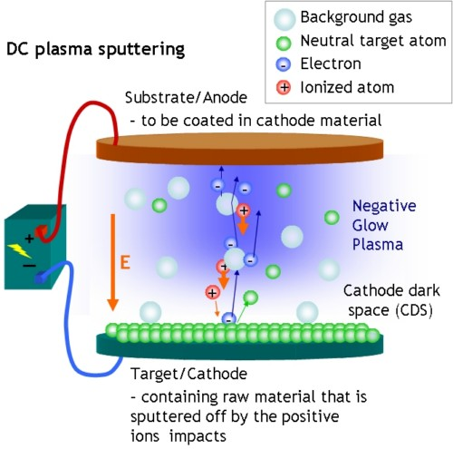
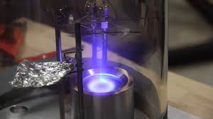
sputtering deposition

Slide 17
Fabrication technology
Substitutional methods
Ion Diffusion
Ion Exchange
Ion Implantation
Epitaxial growth
Molecular Beam Epitaxy (MBE)
Metal-Organic Chemical vapor Deposition (CVD)
Liquid Phase Epitaxy (LPE)

Slide 18
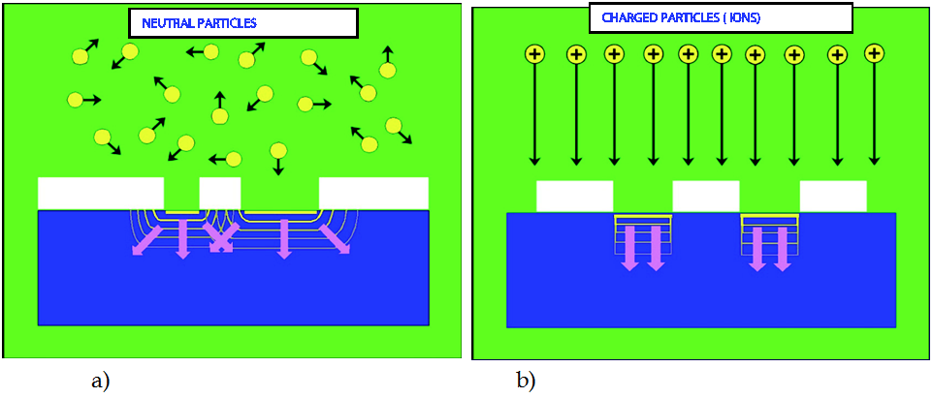
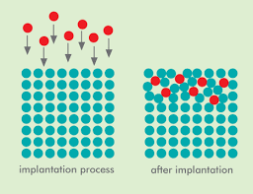
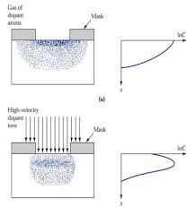
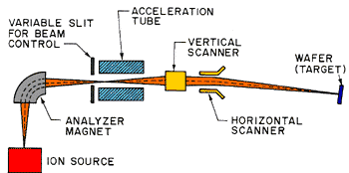
Ion Diffusion & Implantation

Slide 19
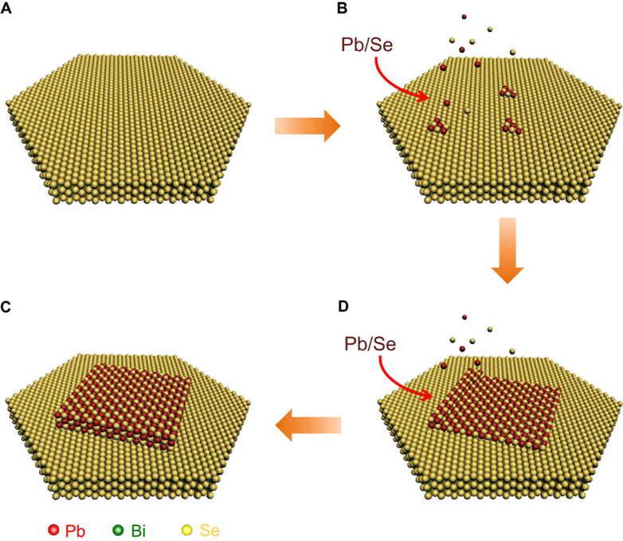
Epitaxial growth

Slide 20
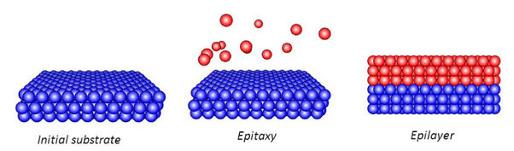
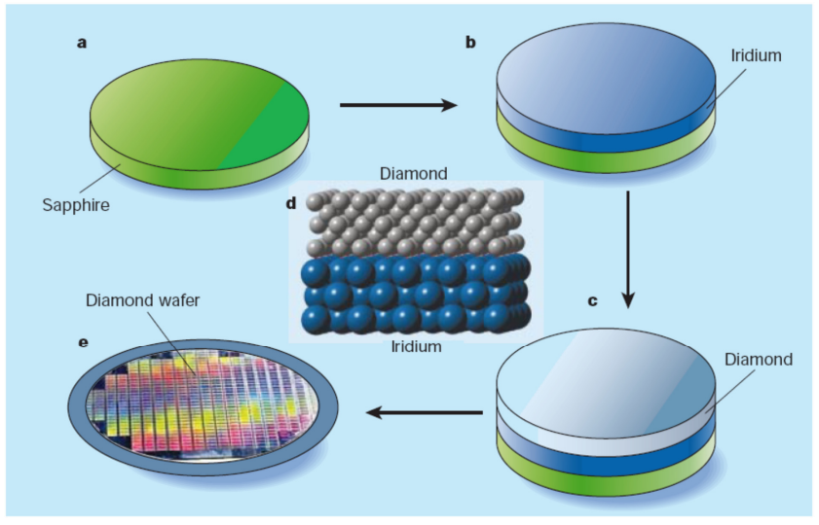
Epitaxial growth

Slide 21
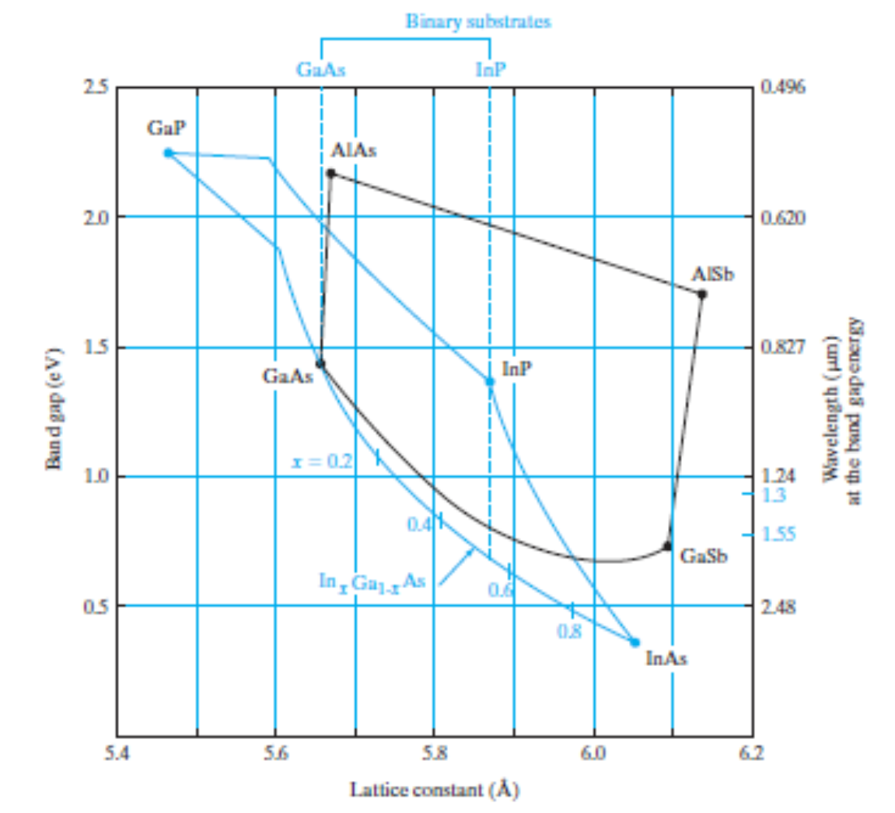
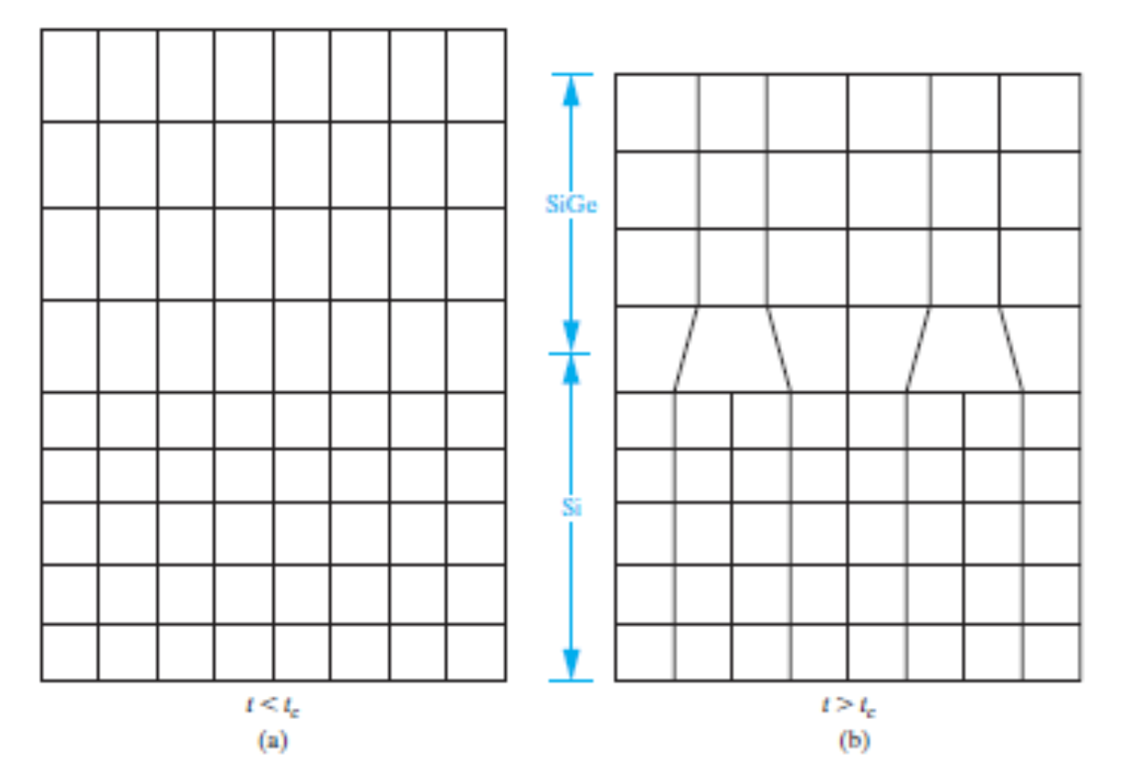
Epitaxial Growth
Lattice-Matching in Epitaxial Growth
Vapor-Phase Epitaxy
Molecular Beam Epitaxy

Slide 23
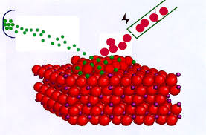
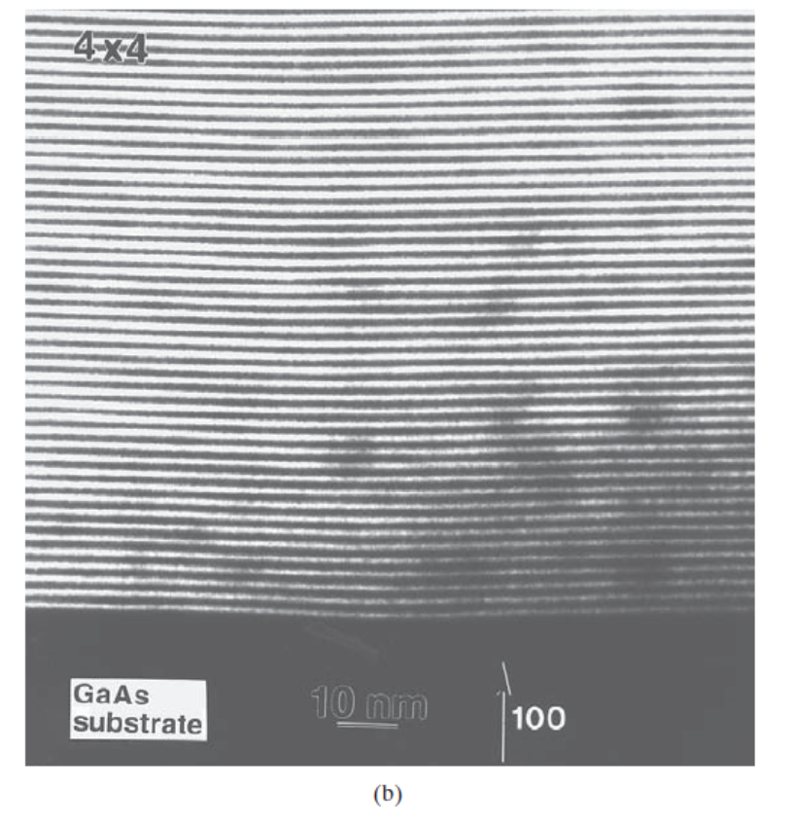
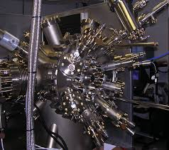
Epitaxial growth MBE

Slide 24
Fabrication technology
Characterizations
Optical Microscope
Scanning Laser Microscope
Scanning Electron Microscope (SEM)
Transmission Electron Microscope (TEM)
Atomic Force Microscope
X-Ray Diffraction (XRD)
Raman Microscope
Scanning Near Field Optical Microscope (SNOM)
Ellipsometer

Slide 25
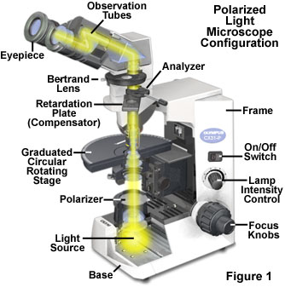
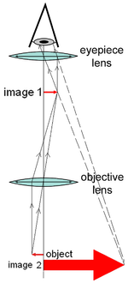
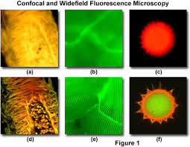
Optical Microscope
Confocal Microscope
Laser Scanning microscope
DIC & Phase Contrast

Slide 26
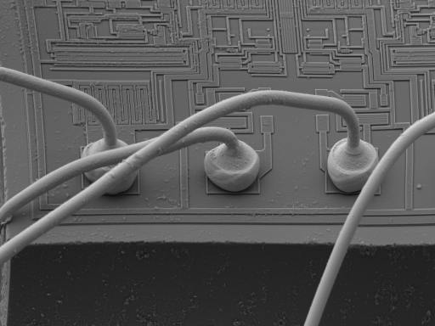
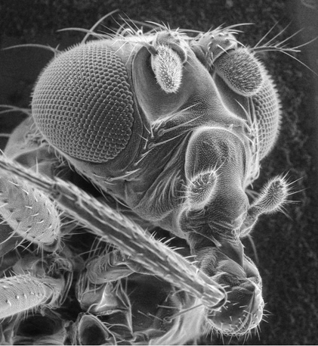
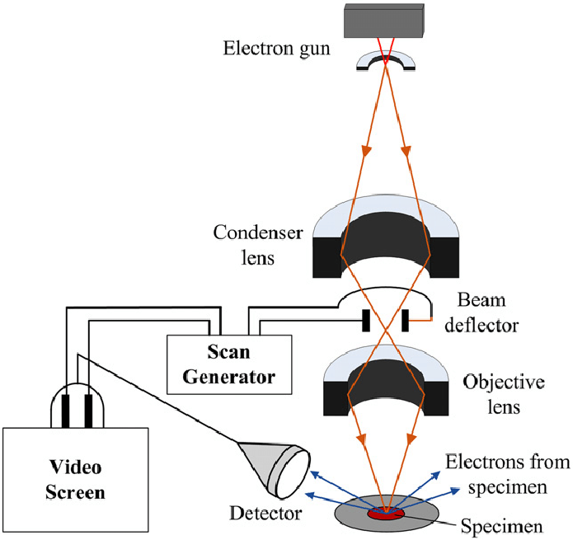
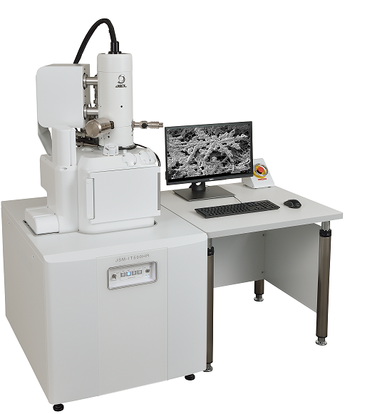
Scanning Electron Microscope (SEM)

Slide 27
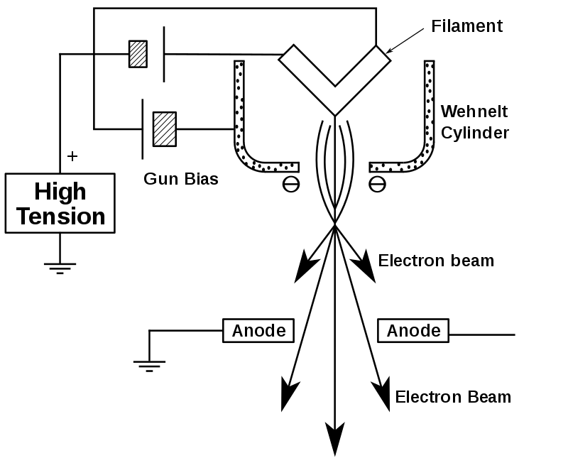

Scanning Electron Microscope (SEM) Electron Gun

Slide 28



SEM Energy-Dispersive X-ray Spectroscopy (EDS), (EDX)

Slide 29





Focused ion beam (FIB)
FIB milling

Slide 30

Transmission electron microscopy (TEM)

Slide 31


Transmission electron microscopy (TEM)

Slide 32






Transmission electron microscopy (TEM)

Slide 33



Atomic Force Microscope (AFM)
Contact Mode
Scanning probe microscope (SPM)

Slide 34



Atomic Force Microscope
Non-contact Mode

Slide 35



Scanning Tunneling Microscopy (STM)
Scanning probe microscope (SPM)

Slide 36



Scanning Tunneling Microscopy (STM)

Slide 37


X-Ray Diffraction (XRD)

Slide 38


X-Ray Diffraction (XRD)

Slide 39

X-Ray Fluorescence (XRF)

Slide 40

Raman Microscopy

Slide 41


Raman Microscopy

Slide 42


Raman Microscopy

Slide 43



Scanning Near field Optical Microscopy (SNOM)
Total internal reflection
Evanescent wave

Slide 44



Ellipsometer

